Slide 1
AES Implementation
2017010 - Agnel Aaron
2017035 - Bharath Kumar Thulasidoss

Slide 2
References
https://csrc.nist.gov/csrc/media/publications/fips/197/final/documents/fips-197.pdf
https://en.wikipedia.org/wiki/Finite_field_arithmetic

Slide 3
Pre-Processing
We first convert the file into 16 byte block and store all the blocks in a list and pass it to our encrypt function.
Naturally the size of last block can vary from 1 to 16 bytes, so we use pkcs5 padding for the last block, which basically means if last block is 14 bytes long we will append ‘2’, two times to the last block

Slide 4
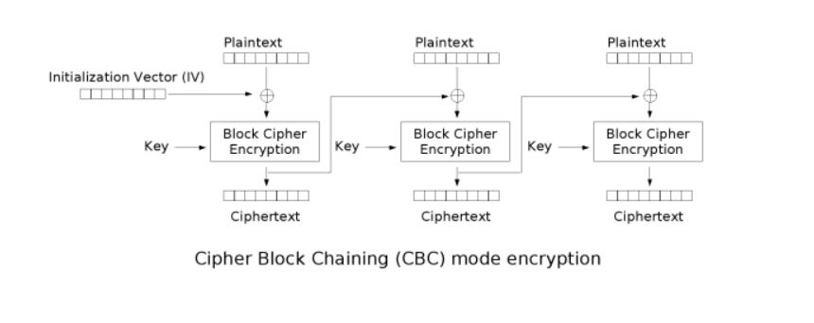
Consequences of Multiple Blocks
Since we can have multiple blocks, we decided to use Cipher Block Chaining (CBC) for encryption and decryption.
We chose a random Initialisation Vector (IV) for CBC

Slide 5
AES Encryption
AES Encryption has individual transformations namely:
SubBytes() - Convert the entry in input to hex, and use the first char as row and second char as col to index into the Rijndael S-Box
ShiftRows() - Applied to the 4 rows in state vector and cyclically shifts each row.

Slide 6
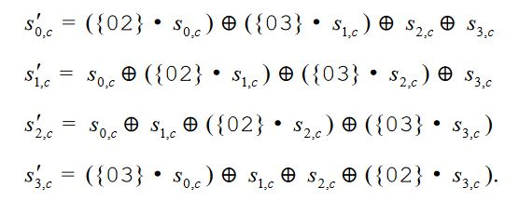
AES Encryption
MixColumns() - Applied to each column of the state vector, where each column is treated as a polynomial in GF(2^8) and multiplied modulo x^4+1.As a result the byte transformation can be condensed to following. (‘.’ is galois multiplication)

Slide 7
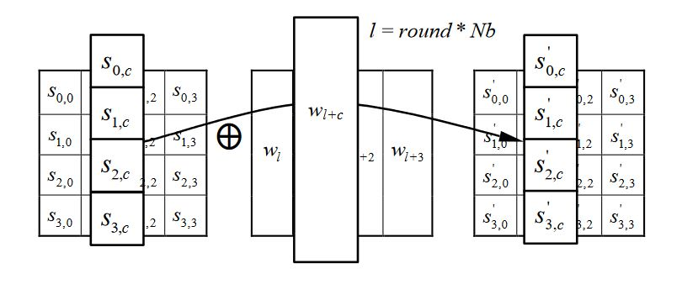
AES Encryption
AddRoundKey - Each column of the state vector (say i) is XOR’s with the ith column of the key schedule, hence the state vector is updated. The key schedule is created by the key expansion function and in our case the keys are stored in a 3d array named ‘subkey’ where the 1st dimension is the round number.

Slide 8
Key Expansion
The Key Expansion function takes in a master key and generates number_of_rounds+1 subkeys that need to be used in their respective rounds.
The first element in the subkey list is the master key.

Slide 9
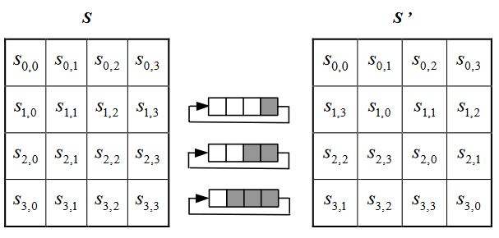
AES Decryption
All the transformations used in AES Decryption are inverses of some transformation used in AES Encryption. Fortunately some transformations are equivalent to their respective inverses like add round key so we can use the already implemented function.
Inverse Shift Rows() - Cyclically shifts rows 2-4 of the state vector

Slide 10
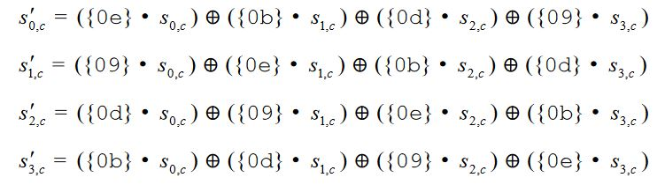
AES Decryption
Inverse Sub Bytes - Convert the input byte into hex and use that to index into the inverse Rijndael S Box.
Inverse Mix Column - Treat each column as a polynomial in GF(2^8) and multiply modulo x^4+1. The individual byte transformations are as follows

Slide 11
Asserting Output of Rounds
In AES , the output of the first round during encryption is equal to the output of the last round during decryption, similarly each round’s output during encryption can be mapped to a particular round’s output during decryption. In our code we assert equivalence of all rounds during encryption with their counterpart round during decryption. In order to be able to do this we store the state vectors of all 10 encryption rounds in an array and similarly store state vectors of all 10 decryption rounds in a different array, and we check equivalence

Slide 12
PKCS5 Padding
Since we pad the last block with extra 16 - size_of_block bytes, after the decryption, the output sometimes has few extra characters upto 15, So after decrypting the last block, we look at its last element and if its a positive number (say x )and x <=15 and the last x characters are also equal to x, then we remove the last x numbers because we have confirmed its padding.

